Slide 1

VetLink for Veterans & Schedulers
OVAC Last Update 06/20/2021

Slide 2
Objective
In this section, participants will be able to:
Define VetLink Kiosk function and usage
Understand the benefits of using the kiosk
Define the general steps for Veterans to use the VetLink Kiosk to check in for appointments and update demographic and insurance information
Notes:
This PPT is informational and for more in depth training contact VPS@va.gov or contact your local VetLink Kiosk POC.

Slide 3
Benefits of the Vetlink Kiosk
The VetLink application empowers Veterans to be more engaged in their healthcare by allowing them to see their information, update their demographic and insurance information, and improve the delivery of their healthcare in many different ways.
Using VetLink kiosks:
Reduces check-in wait time for Veterans
Reduces wait time for Beneficiary Travel reimbursement
Provides more flexible and efficient patient flow at the VAMCs and CBOCs
Increases seamless communication between the front desk and back offices of the clinics
Allows VA staff additional time to perform additional Veteran related tasks
Assists in the maintenance of accurate personal and insurance information

Slide 4
Veteran Kiosk Flow
The Veteran check-in workflow consists of the following steps:
Conduct patient authentication
Review and update patient demographics
Review health insurance and note changes
Review arrival information/transportation needs (optional)*
Review today’s appointment(s) and check in to next appointment
Review future appointments (optional)*
Review outstanding balance, if records show an unpaid balance
Million Veteran Program (MVP) (optional)*
*Please note, the options available through the kiosk may vary from facility to facility
Notes:
Please note, the options available through the kiosk may vary from facility to facility. Please indicate what your facility is able to do with the kiosk functionality. A review of the Kiosk Walkthrough Simulation is available on the Vetlink training site: http://www.vetlinkassist.com/

Slide 5
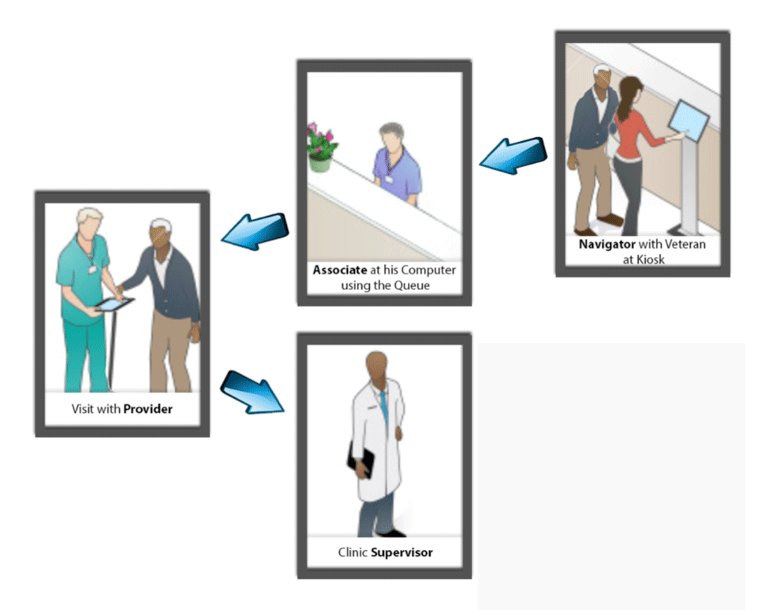
Using VetLink
Patients check in at VetLink kiosk
Patient flow can be monitored by MSAs, Nursing Support, Providers and Clinic Supervisors
Notes:
Navigators:
Provide assistance to Veterans using VetLink
Address Veterans’ concerns
Maintain VetLink by keeping kiosks clean and supplying them with paper
Report kiosk problems to supervisor

Slide 6
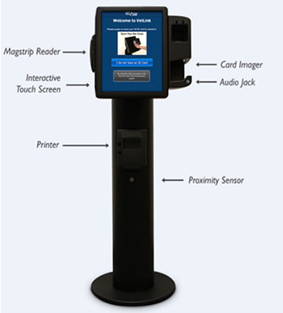
VetLink Kiosks

Slide 7
Typical Patient Check-In Flow
Touch the Kiosk Check-In Option
Authenticate
Check In
Have a Seat in Waiting Room

Slide 8
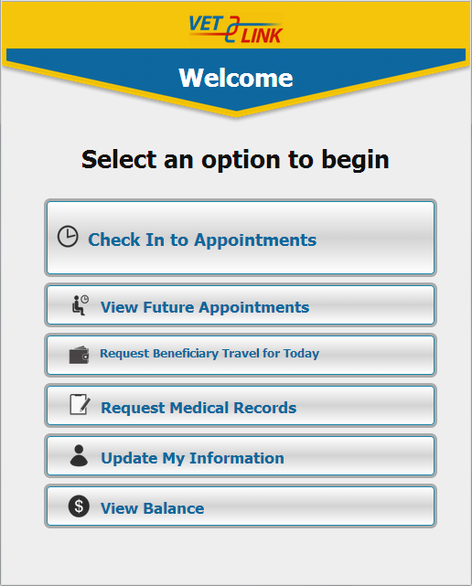
Veteran Options
Appointment Check-In
View Future Appointments
Request Beneficiary Travel
Directions to Appointments
Request Medical Records
Update Personal Information
Review account information
Review insurance information
*The main menu can be configured based on the location.
Notes:
The options listed above are available, however, your facility may have elected to only use some of the options in the VetLink kiosk. The main menu can be configured based on the location. These options aren't enabled on every kiosk AND there's the ability to add queuing/walk-in Please contact your local POC to understand what options are offered at your local facility.

Slide 9
ID Check-In
ID Check-In Options
Swipe VA ID card
Scan VA ID Card
Manually enter SSN

Slide 10
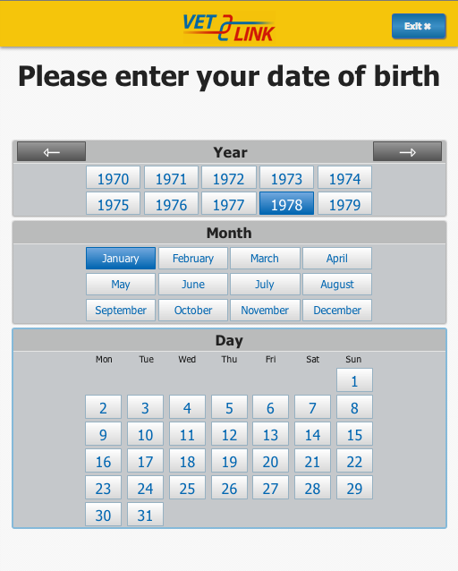
Verification Screens – DOB
Veteran selects year of birth
Veteran selects month of birth
Veteran selects day of birth

Slide 11
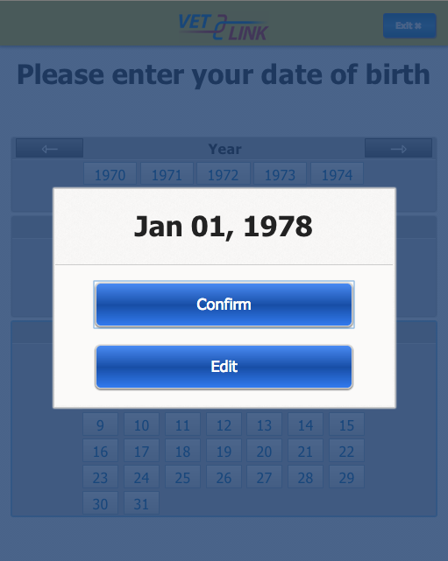
Verification Screen Confirm
Veteran confirms date of birth

Slide 12
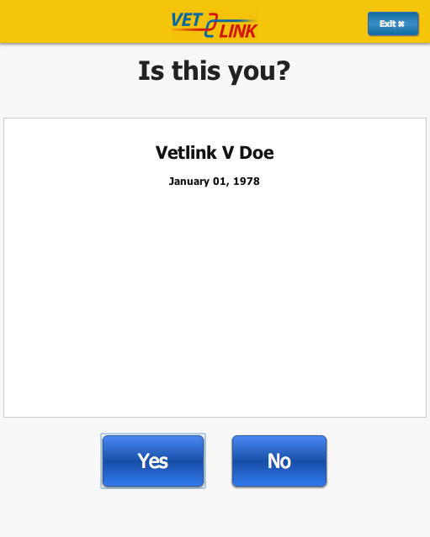
Pre-Registration Check-In
Veteran confirms identity

Slide 13
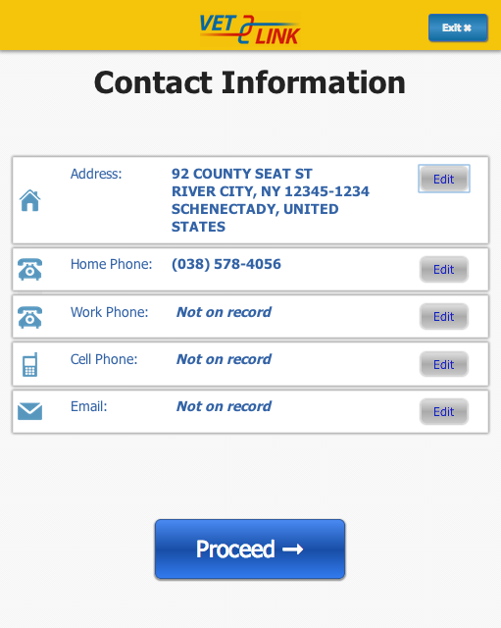
Pre-Registration Check-In (2 of 5)
Veteran confirms or edits contact information
Notes:
If the Veteran is in

Slide 14
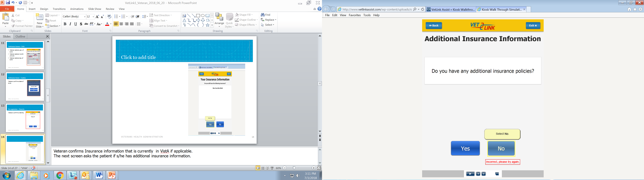
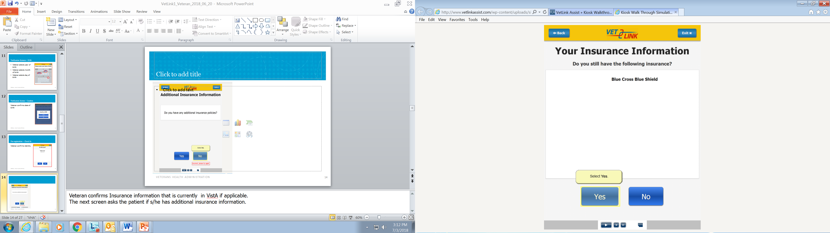
Veteran Insurance Verification
Notes:
Veteran confirms Insurance information that is currently in VistA if applicable.
The next screen asks the patient if s/he has additional insurance information.

Slide 15
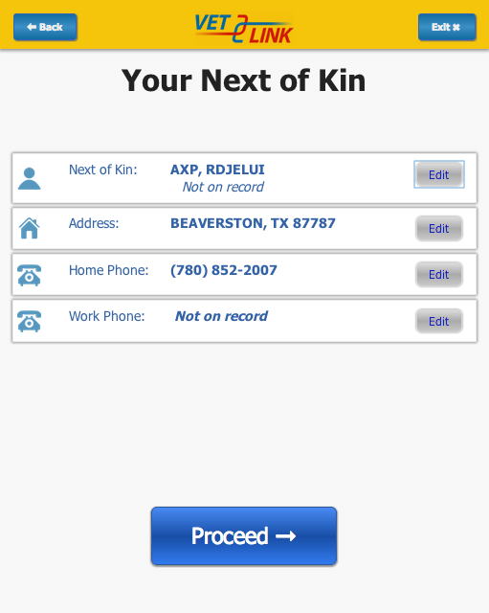
Pre-Registration Check-In (3 of 5)
Veteran confirms or edits Next of Kin information

Slide 16
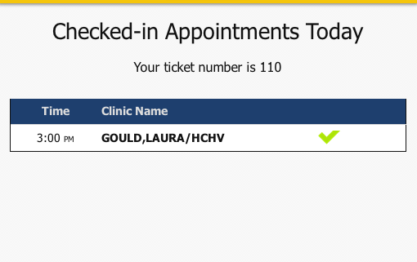
Appointments Screen
Today’s appointments are listed and checked in
The first screen will list the appointments in which the Veteran is about to check in
The next screen confirms Veteran has checked in
BOLD GREEN CHECK MARK—Veteran has successfully checked in for appointment using VetLink
UNEMPHASIZED BLACK TEXT–Veteran is not being checked in for that specific appointment

Slide 17
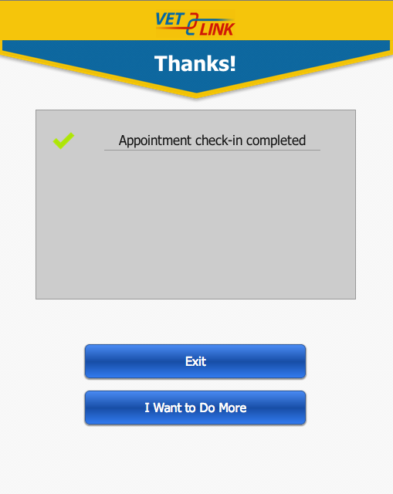
Pre-Registration Check In (4 of 5)
Click “Exit” to conclude and wait to be called
Or click “I Want to Do More”

Slide 18
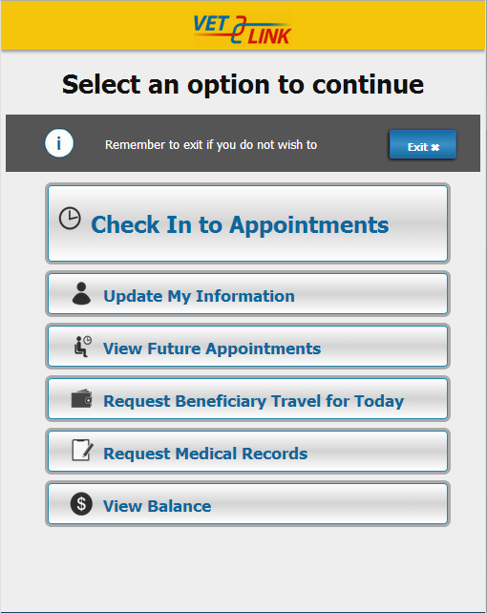
Pre-Registration Check In (5 of 5)
Clicking “I Want to do More” directs the Veteran back to the “Options” menu.
Notes:
By the patient selecting the button, “I want to do more” another screen appears giving the patient a list of options for the patient to select what to do next.

Slide 19
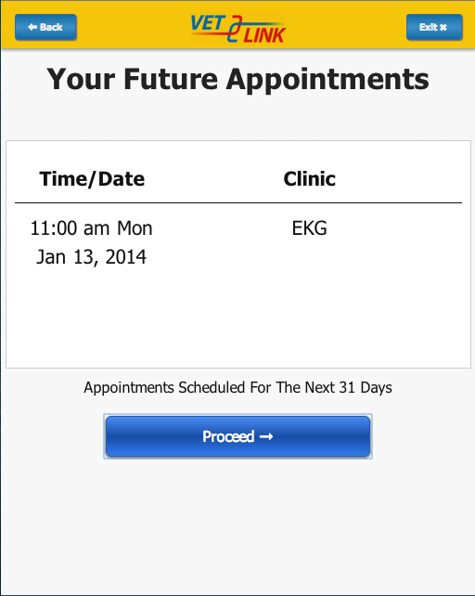
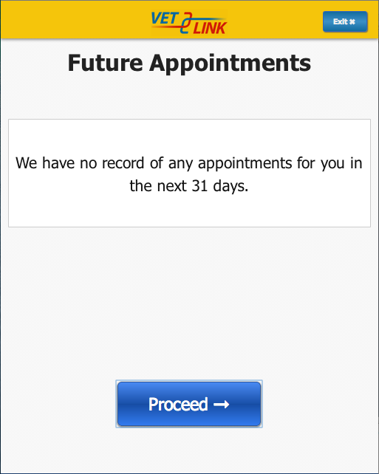
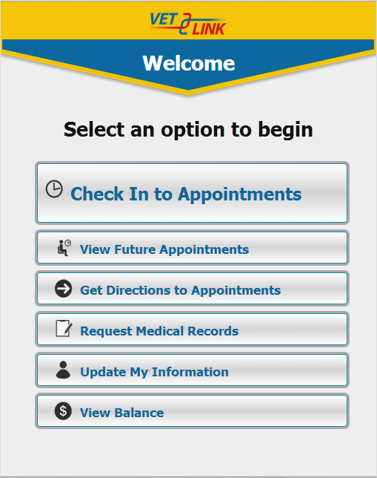
View Future Appointments
Notes:
An example of what can be selected is the “view future appointments” Option. Above are three screens that show what occurs when the patient makes the selection.

Slide 20
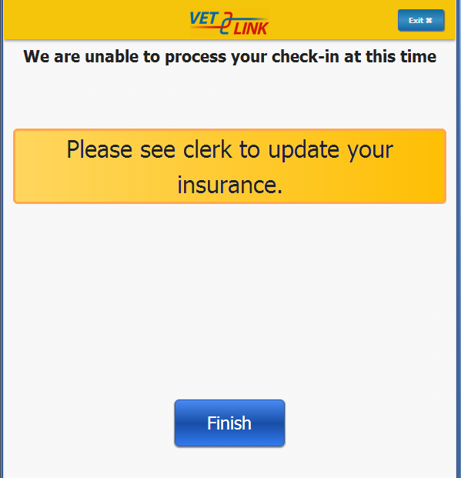
Hard Stops
Hard Stops are included which prevents patients from checking in when certain conditions are met or not met, involving:
Enrollment and Eligibility
Means Test
Too Early / Too Late
Wrong Area
No Appointment
Insurance Verification Indicated
Notes:
A hard stop will occur when the Veteran has ANY changes to their insurance, They will be asked to see a MSA to finish their check-in process.
As an MSA you will Manually Check them in and record their insurance changes using ICB.

Slide 21
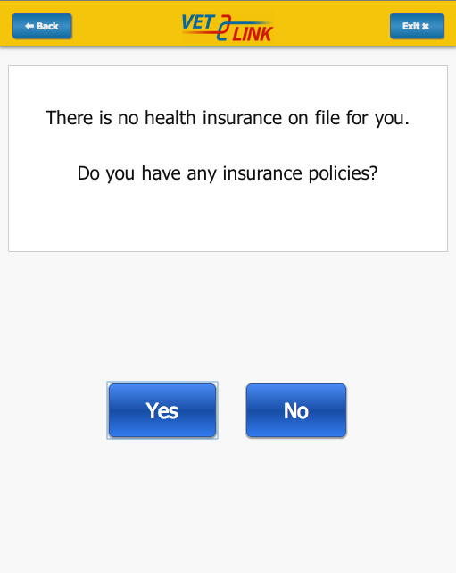
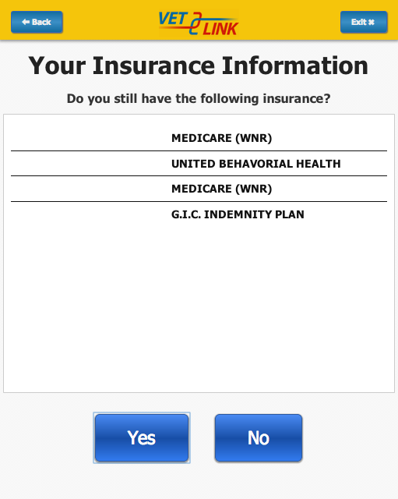
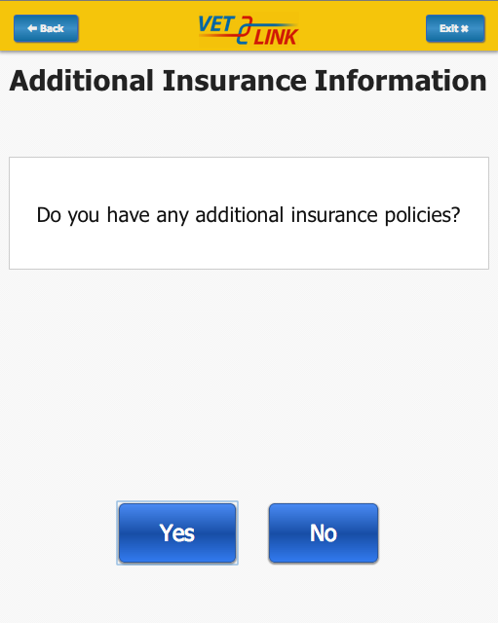
Insurance Hard Stops
A hard stop can be enabled to cause a Veteran to be directed to staff if the Veteran indicates there is ANY change to Insurance
Notes:
A hard stop will occur when the Veteran has ANY changes to their insurance, They will be asked to see a MSA to complete their check-in process.
As an MSA you will Manually Check them in and record their insurance changes using ICB.

Slide 22
VetLink for Schedulers

Slide 23

Objectives
In this section, participants will be introduced to VetLink, learn an overview of the general navigation of VetLink to monitor patient appointment check-in and flow, and access and validate information in VetLink.
Notes:
This PPT is informational and for more in depth training contact VPS@va.gov or contact your local VetLink Kiosk POC.

Slide 24
The MSA Experience with VetLink
Appointment schedulers and managers support the VetLink kiosks as VetLink associates. The VetLink associate plays an essential role:
Managing patient information and coordinating the flow of the patient’s visit
Acts as the liaison between Veterans and the medical staff
Managing Veterans in the patient queue
Reviewing and updating the patient queue
Looking up and manually checking in Veterans, when needed
In addition, this role covers materials for users who work with the admin patient queue for the optional workflows, including beneficiary travel, release of information and non-integrated patient queuing.
As associates, these users may move Veterans through the queuing process and access patient information.
Notes:
Appointment schedulers and managers support the VetLink kiosks as VetLink associates. The VetLink associate plays an essential role in managing patient information and coordinating the flow of the patient’s visit. Associates act as the liaison between Veterans and the medical staff that serve them. Associates work closely with Veterans to maintain and update their demographic and insurance data, ensuring accuracy and availability of the most current information. In the event a Veteran does not check in using a kiosk, the associate uses VetLink to manually check in the Veteran. Associates are key in ensuring the highest quality patient care.
In addition to the associates who work within clinics, this system role covers materials for users who work with the admin patient queue for the optional workflows, including beneficiary travel, release of information and non-integrated patient queuing. As associates, these users may move Veterans through the queuing process and access patient information.

Slide 25
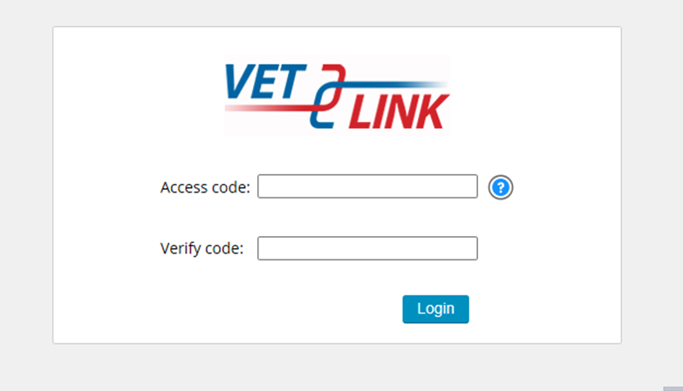
Signing Into VetLink
Each VA Healthcare site has its own URL to access the application and uses your VistA/CPRS Access/Verify codes to log you in. Please check with your local VetLink Kiosk point of contact (POC) for further information.
Notes:
Access to this site and portal is reviewed, approved, and set-up by the local VetLink Kiosk POC or site lead. Each VA Healthcare site has its own URL to access the application. Please check with your local VetLink Kiosk point of contact for further information.
A list of the facility Vetlink/Kiosk Points of Contact across the country can be found at this link: https://www.vapulse.net/docs/DOC-17370

Slide 26
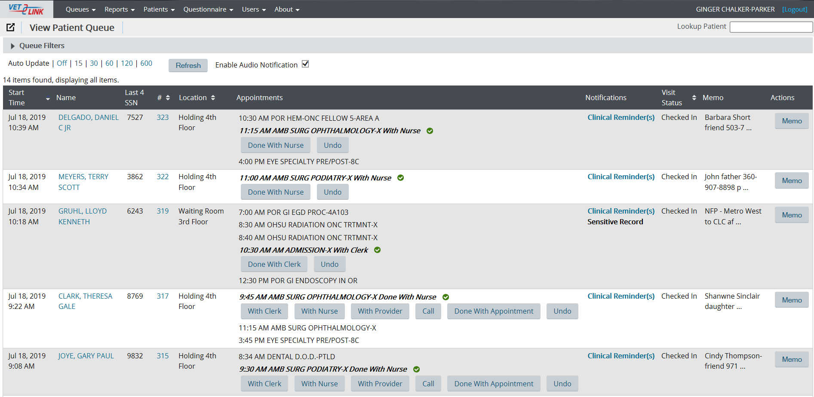
Patient Queue
Notes:
Above is the patient queue that allows the scheduler to follow the patient’s flow. This is what the patient queue would look like in VetLink. For the patient to be viewable on this queue, the patient would either check-in themselves via the kiosk associated with a particular clinic or the scheduler can manually check the patient into VetLink at the scheduler’s desktop.

Slide 27
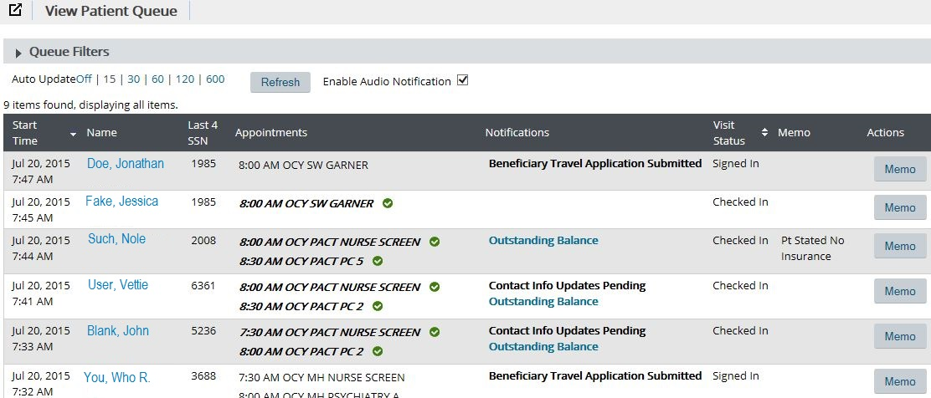
Patient Queue (cont.)
Provides real-time snapshot of Veterans who have checked into VetLink, sorted chronologically
The default view shows Veterans who have checked in using the VetLink software either while checking in at the Kiosk or checking in with the scheduler using the VetLink software on current day

Slide 28
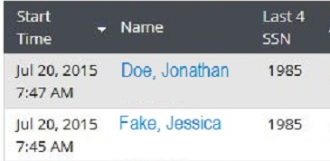
Screen Contents – Columns 1-3
Time that Veteran started using a VetLink kiosk or was checked in by VA Staff using VetLink
Full name of the Veteran
Last 4 digits of the Veteran’s SSN
1
2
3
Notes:
Closer look from previous slide graphic – first three columns from left to right of screen

Slide 29
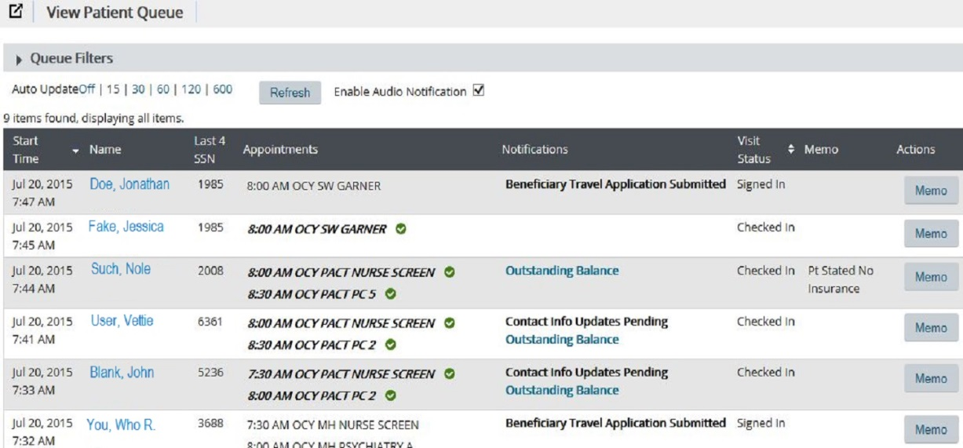
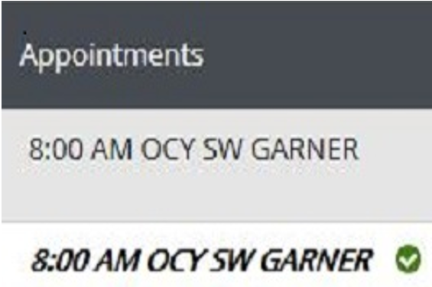
Screen Contents – Column 4
List of today’s appointments for each Veteran in patient queue:
BOLD GREEN CHECK MARK—Veteran has successfully checked in for appointment using VetLink
UNEMPHASIZED BLACK TEXT–Veteran has not checked in for that particular appointment time during this kiosk session
Notes:
Review content of slide with the learner. Emphasize that the check mark means the patient has checked into the appointment.
List of today’s appointments for each Veteran in patient queue:
BOLD GREEN CHECK MARK—Veteran has successfully checked in for appointment using VetLink
UNEMPHASIZED BLACK TEXT–Veteran has not yet checked in for that particular appointment time during this kiosk sessions - it just means they didn't check in for that appt at this kiosk activity. e.g. if they have an 0800 and 1000 but checked inf or the 0800 earlier, the appt check-in for the 1000 would show the 1000 as the green/bold/checkmark

Slide 30
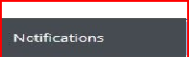
Screen Contents – Column 5
5. Notifications are Veteran-specific information from VistA or information regarding the Veteran’s VetLink interaction.
Some notifications are hyperlinked for additional info appears and can be selected to provide more details.

Slide 31
Admin Patient Queue: Sample Notifications
Notification | Meaning | Hyperlinked Information
Behavioral Pt | Veteran has a behavioral flag in VistA | All behavioral narratives for the patient in VistA
Contact Info Updates Pending | Veteran has updated contact information and those changes have not been approved yet
Wrong DOB Entered | DOB Veteran entered does not match DOB on file | DOB that Veteran entered
Exited | Veteran exited the program
No Appointments For Check-In | Veteran is too early, too late, in the wrong area, or already checked in for all of their appointments today | The appointment name and the reason why the appointment could not be checked in

Slide 32
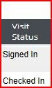
Screen Contents – Column 6
Visit Status indicates where the Veteran is in the visit cycle:
Started Interaction
Signed In: Veteran has verified his or her identity but has not checked in for an appointment
Checked In: Veteran has completed the kiosk workflow process and checked in for at least one appointment
6

Slide 33
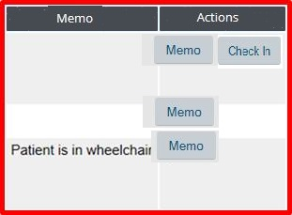
Screen Contents – Columns 7 & 8
Memo column allows you to record internal information about the Veteran that does not contain any Personal Identifiable Information (PII) or Patient Health information (PHI).
8. Actions column provides the button used to create a note or check in a Veteran who has not completed the process at kiosk
7
8
Notes:
Example of what to put in Memo section include but are not limited to: Room number, pt readiness, annotations about insurance, etc. When the user clicks on the memo button, it allows the user to document notes in the “memo” section. Remember no communication about the patients clinical treatment or health should be annotated in this area.

Slide 34
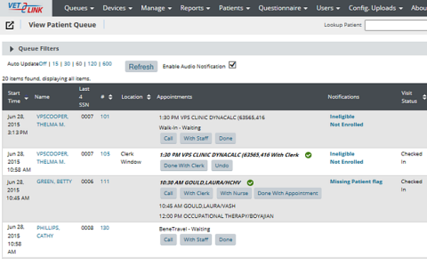
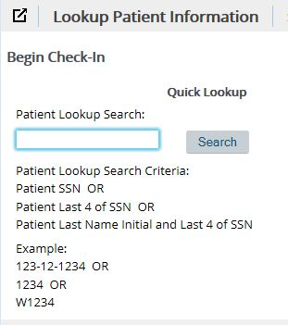
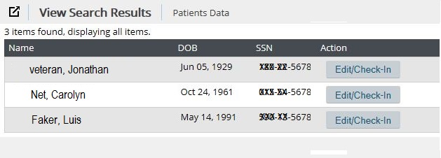
Manual Check in
Using either the Patient Lookup page or widget, enter one of the following:
Full SSN
Last 4 of SSN
First initial of last name and last 4 of SSN
Select Search
If multiple records are returned, use patient DOB
Select EDIT/CHECK-IN button next to the appropriate Veteran
Notes:
Trainer will review the information on the slide wit the learner. The method described is when the scheduler uses the Lookup Patient Information to retrieve patient info and start the check-in process. The top and bottom pictures directly beside the write up are examples of what the scheduler will see. The picture to the top far right is the a different why of accessing the patient information using the Patient Queue. You can also use the patient look up in the Patient Queue.

Slide 35
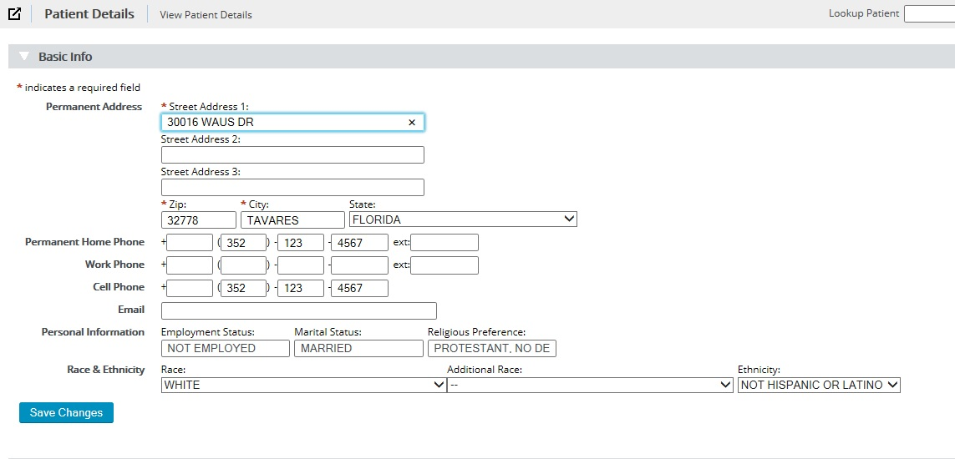
Manual Pre-Registration & Verification
Verify Veteran Demographic Information
Notes:
Pre-Registration
Verify Full Name
Verify DOB
Verify Address
Verify Phone #
Verify Email
Verify Next of Kin
Verify Insurance

Slide 36
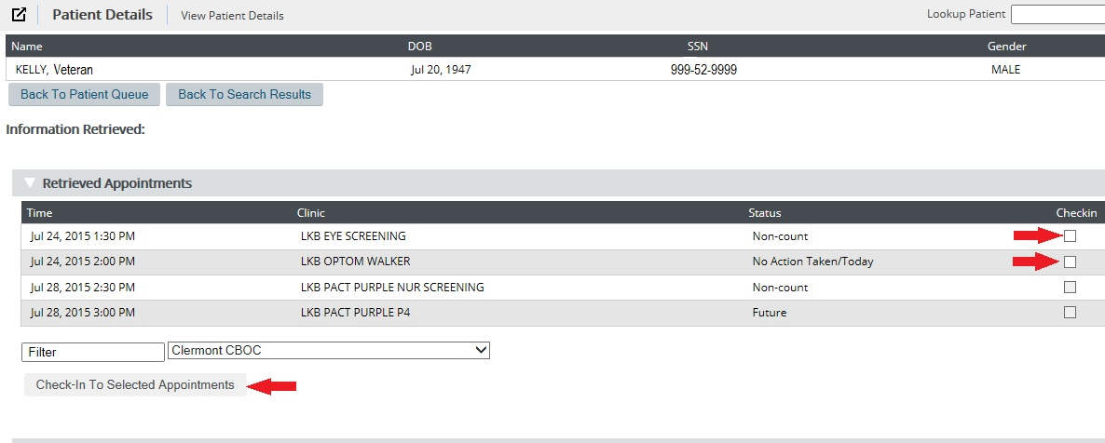
Manual Check-In: Verify Appointment
Confirm time & location of appointment

Slide 37
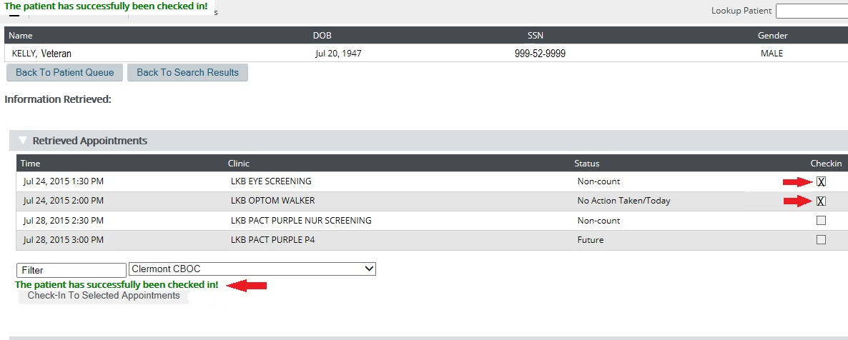
Check-In – Success!
Check In Confirmed:
Message appears in GREEN indicating that patient has been checked in
Notes:
Check In Confirmed:
Click on BOTH SCREENINGS and actual APPOINTMENT
Once checked in message appears in GREEN indicating that patient has been checked in

Slide 38
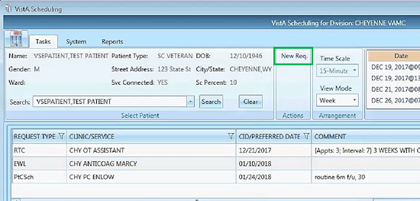
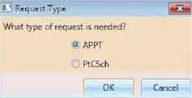
VetLink: Unscheduled Appointments
An unscheduled appointment can not be made in the VetLink software.
The appointment should be made in VS GUI/VistA and then checked in using the VetLink software.
Follow clinic WALK IN and UNSCHEDULED process to make a same day appointment.
Below are the steps in VS GUI:
Remember - VS GUI needs a Request before an appointment can be scheduled
Search for the Patient
Create a new APPT request*
Notes:
An unscheduled appointment should not be made in the vetLink software. The appointment should be made in VS GUI/VistA and then checked in using the VetLink software.
Follow clinic WALK IN and UNSCHEDULED process to make a same day appointment. Below are the steps in VistA:
Remember - VS GUI needs a Request before an appointment can be scheduled
Search for the Patient
Create a new APPT request
*After the appt request in created, the system will automatically take the scheduler to the check-in screen. When that happens, the scheduler just selects “cancel” and goes back into VetLink to complete the check process.

Slide 39
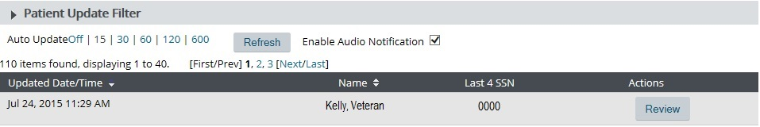
Approve Patient Update Queue
Target processing for as close to real-time as possible.
A notification will appear in the Patient Queue when updates are pending. This notification disappears when the update is processed.
Supervisors to review daily to ensure completion.
Notes:
Ideally this is cleared by staff ASAP, if not that then hourly, but definitely by COB...but I'd still put ASAP as there are immediate negative actions that can happen if say an 0800 appt doesn't get their info approved until 1630

Slide 40
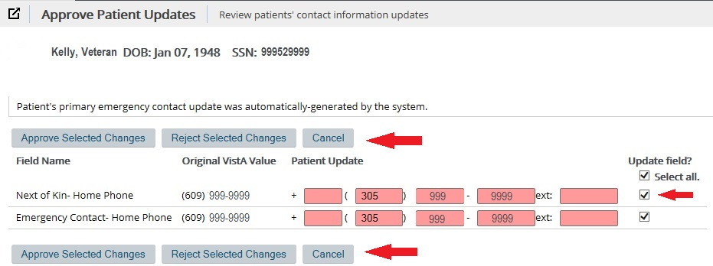
Patient Update Queue (cont.)
Target processing for as close to real-time as possible
Supervisors to review daily to ensure completeness
Notes:
Arrows are pointing toward the ways in which the demographic changes made by the patient can be approved or rejected; selection box to “select all” the information listed.

Slide 41
User Templates
What is a User Template?
A custom view of the Patient Queue (e.g. Audiology Clinic) that is set up or assigned by an administrator when first authorizing a staff user’s account
Why is a User Template important?
Helpful when an Associate covers multiple clinics or shifts and needs to focus their attention on a particular set of patients at one time
Limits the total list of VetLink interactions to the ones a particular user is responsible for
User template is changed first when changing queue filters
Template is updated which changes the Patient Queue filter settings

Slide 42
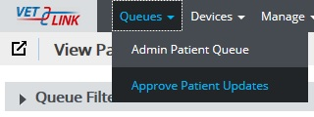
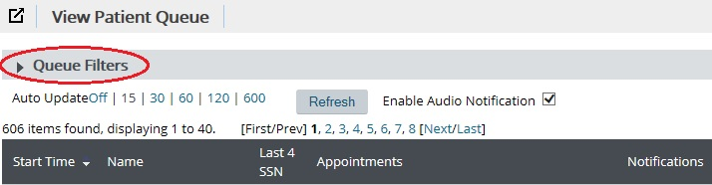
Patient Filtering Queue
Select Queues tab
Select Admin Patient Queue
Select “15” for Auto Update
Select the row that contains “Queue Filters” to expand queue filter options
A
B
C
D

Slide 43
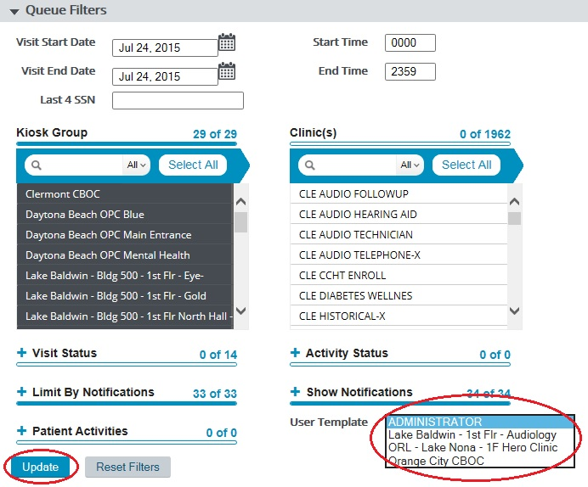
Queue Filters: Change Clinics
User Template Dropdown List
Select another template (only applicable if you have multiple templates assigned) or modify available filter options
Select Update
Notes:
Please note, if you Float/Change clinics – then you would need to change your assigned User Template to the area you move to.

Slide 44

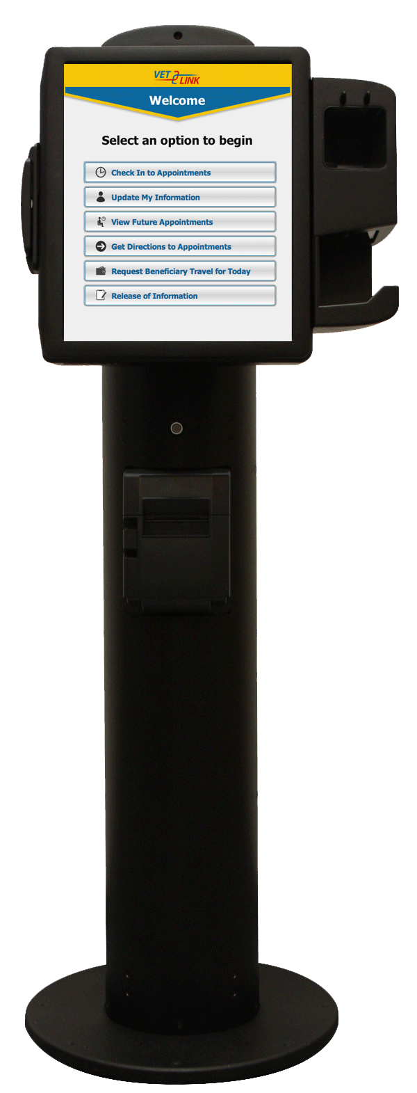
Basic Hardware & Preventive Maintenance
Clean the Kiosk Screen
With authorized cleaners and cloths
Non-ammonia-based cleaners
Tilt the Screen
Clean the Card Swipe
Check the Printer
Clean the Kiosk Body

Slide 45

Demonstration
Notes:
Please have the Vetlink Coordinator provide a demonstration of what the system looks like. Staff should follow-up with supervisor and local Vetlink Kiosk POCs for access approval and access.

Slide 46

Questions

